Slide 1
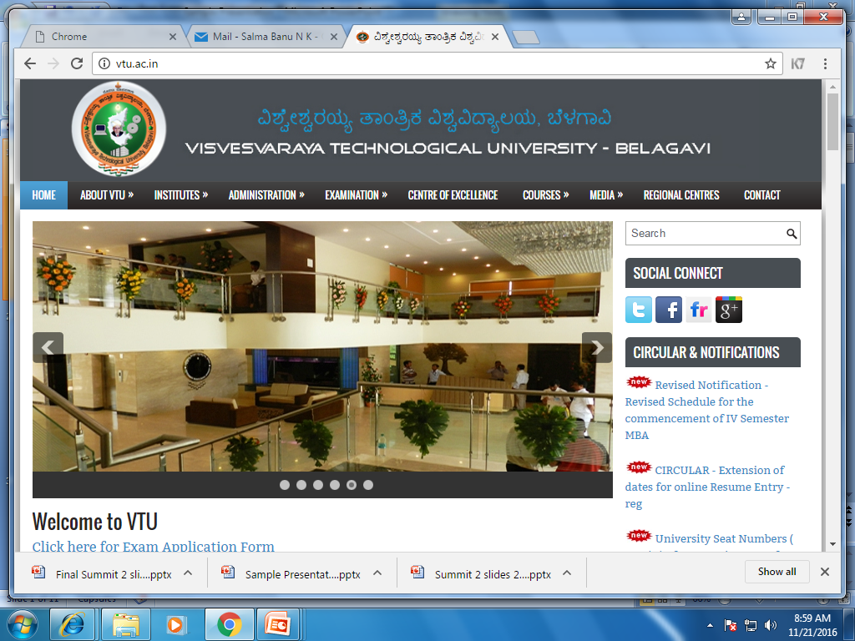
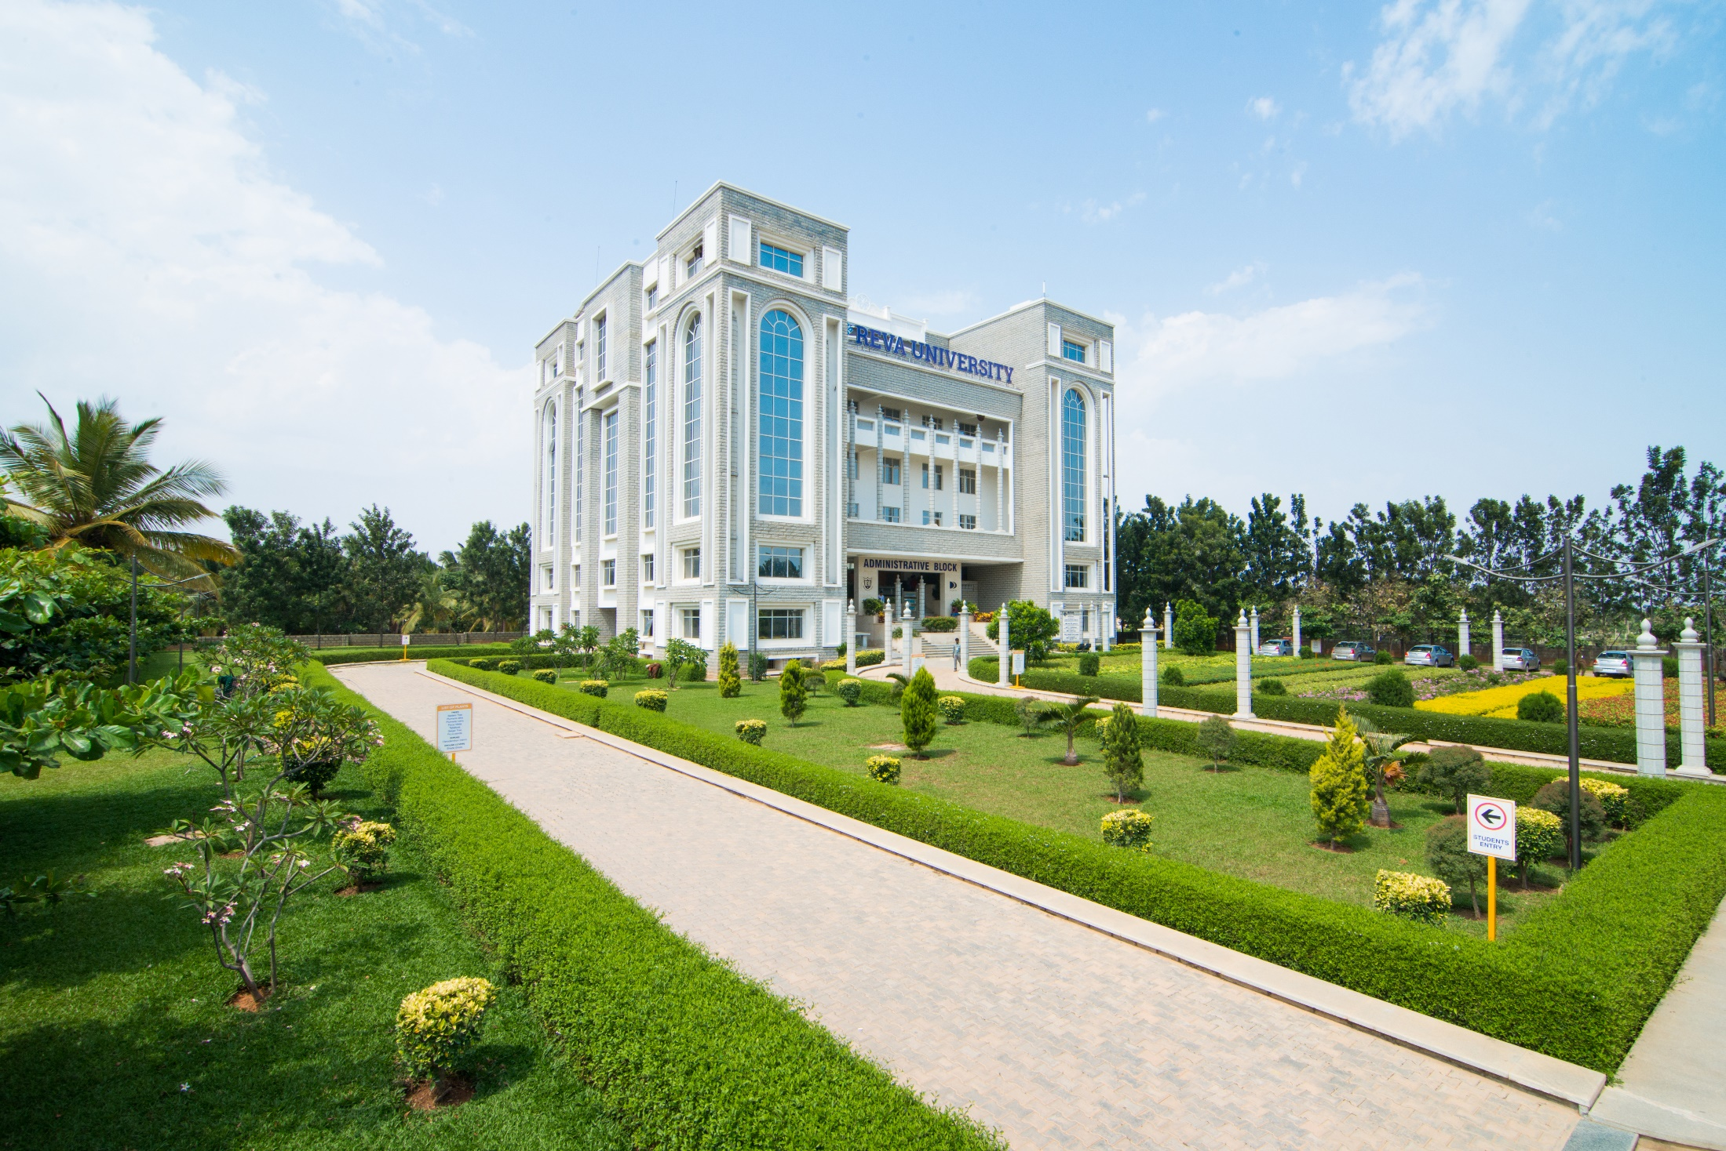
DEPARTMENT OF COMPUTER SCIENCE & ENGINEERING
REVA INSTITUTE OF TECHNOLOGY AND MANAGEMENT

Slide 2
8th Semester Phase 1 Presentation
Code Integration System

Slide 3
Code Integration System
Presented By,
Midhun Mathew (1RE13CS088)
Ruhil Jaiswal (1RE12CS085)
Karthik Hegde (1RE13CS062)
Under the Guidance of
Dr. M Prabhakar,
Associate Professor

Slide 4
Content
Introduction
Idea: Core
Idea: Platform
Architecture
Future work: Phase 2
Conclusions
References

Slide 5
Introduction
Pain Points:
* Rapid growth of technology.
* Best implementation for a functionality.
* Re-usability of the code
The system analyzes the code, stores the most efficient functions in the code repository as and when encountered.
The major modules of this system are :
i.A performance evaluator engine
ii.Central repository
iii. Testing unit

Slide 6
Idea: Core (CIS_Dexter)
Context
Comparing 2 functions
Checking their validity
* math models
* properties of the elements involved

Slide 7
Idea: Platform (CIS)
Idea:
* develop a platform where the programmer can write program without coding.
* ability to ask how to do something, knowing what to do.
* code reuse
Approach:
* Give a tag, get a function
*

Slide 8
Architecture
Cis
Rest-server
Math model generator
Web ui
Mongo db database
Method invocation

Slide 9
Phase 2: Plans
P&H(scale)
Credit
Ui to add func (ace edit)
Visual
Context (tags - word2vec)
Language or pipeline

Slide 10
Advantages
reusability of code
compare code
  assessments
  ranking
visual results for the function
retrieval of functions, mapping with tags
testing using restrictions/ constraints on the input

Slide 11
Hw/Sw Requirement
Software requirements :
Operating System :
server: Linux (ubuntu 16.04)
database: Linux (ubuntu 16.04) / windows
Tools: Python3, Mongodb, CherryPy,
Hardware requirements ( developed on )
Processor : intel core i5
Memory : 4GB Ram or higher
Hard disk space : 2GB or more
Note : system requirements maybe subjected to change.

Slide 12
Conclusions
visual aid for development and analysis
compare code of different languages
reduced plagiarism
credit for work
frequent enhancements

Slide 13
References
Enrique FLores ,Alberto Barron-Cedeno Towards the Detection of Cross-Language Source Code Reuse(2011)
Arwin, C., Tahaghoghi, S.M.M.: Plagiarism Detection across Programming Languages
D. Binkley "Source Code Analysis: A Road Map" IEEE Future of Software Engineering (FOSE'07)2007.

